Slide 1
POI Data Quality Analysis
Elmedina Ćiber

Slide 2
Contents
Introduction
About the dataset
Initial analysis
Unstandardized Data
Data Classification
Conclusion
/ 21

Slide 3
Introduction
Initial analysis
Unstandardized data
Classification
Conclusion
Internship
Introduction
Owner of www.navigator.ba point of view
Looking to expand location coverage
Potential POI dataset purchase
Analyse quality of POI dataset before purchasing
Key objective: divide dataset into low, medium and high quality subsets
/ 21

Slide 4
Introduction
Initial analysis
Unstandardized data
Classification
Conclusion
Internship
About the dataset
Source: San Francisco Restaurant Inspection Scores
52,315 records
Information about:
- POIs
- Inspection visit details
One record is one inspection violation
/ 21

Slide 5
Initial analysis
/ 21

Slide 6
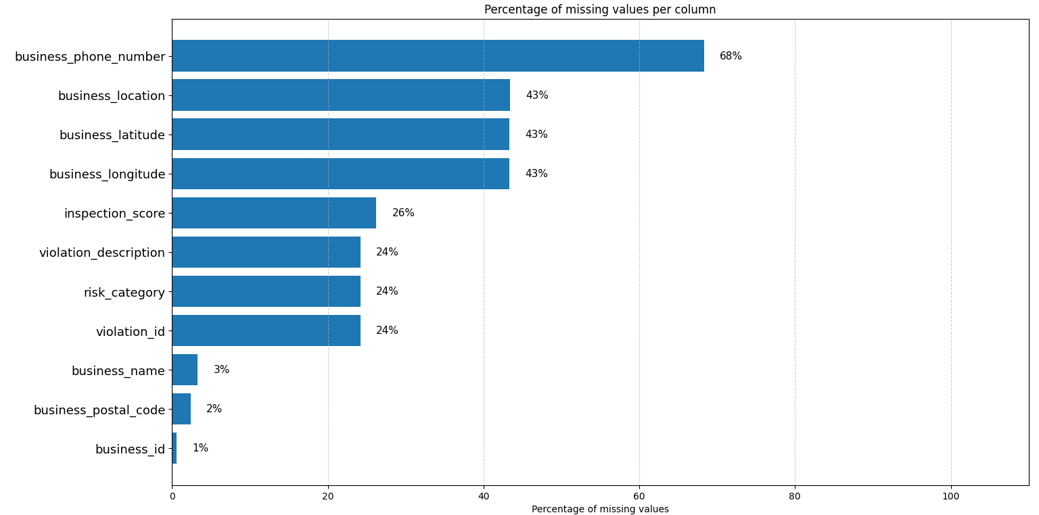
Introduction
Initial analysis
Unstandardized data
Classification
Conclusion
Internship
Completeness
Identify columns
with missing values
/ 21

Slide 7
Introduction
Initial analysis
Unstandardized data
Classification
Conclusion
Internship
Frequency
Number of unique values in columns
Values that occur frequently
Analysis on relevant columns
City values: San Francisco and SF
State values: California, CA, and IL
State | Frequency
CA | 99.5%
IL | 0.3%
California | 0.2%
/ 21

Slide 8
Introduction
Initial analysis
Unstandardized data
Classification
Conclusion
Internship
Dummy values
“Fake” value
NA, Not applicable, -
Hard to predict the form
Found in:
- Name
- Address
- Phone number
Name
NA
Hidden
Unavailable
Address
Unnamed ST
Private Locations
Off The Grid
Phone number
unde
null
not
na
NA
/ 21

Slide 9
Introduction
Initial analysis
Unstandardized data
Classification
Conclusion
Internship
Duplicate POIs
Found using combination of name and address
Out of 53,811 records, only 12% unique POIs
/ 21

Slide 10
Unstandardized Data
/ 21

Slide 11
Introduction
Initial analysis
Unstandardized data
Classification
Conclusion
Internship
Unstandardized data
All columns checked
Found in:
- Name
- Address
Name | Address
Norman's Ice Cream and Freezes | 2801 Leavenworth St
CHARLIE'S DELI CAFE | 3202 FOLSOM St
Name | Address | City
BUS STOP PIZZA #1 | Divisadero St | San Francisco
Garden of Eden | 340 PO BOX | San Francisco
/ 21

Slide 12
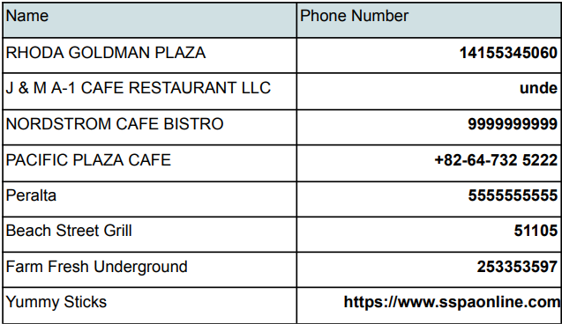
Introduction
Initial analysis
Unstandardized data
Classification
Conclusion
Internship
Unstandardized data
Found in:
- City:
~ San Francisco
~ SF
- State:
~California
~ CA
~IL
Phone number
/ 21

Slide 13
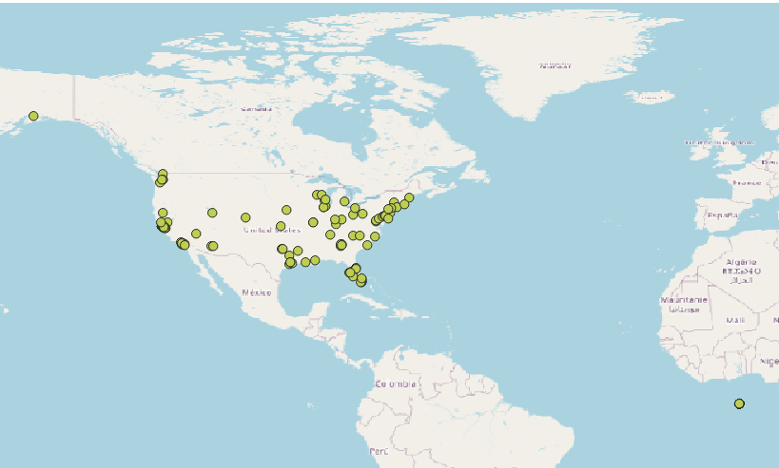
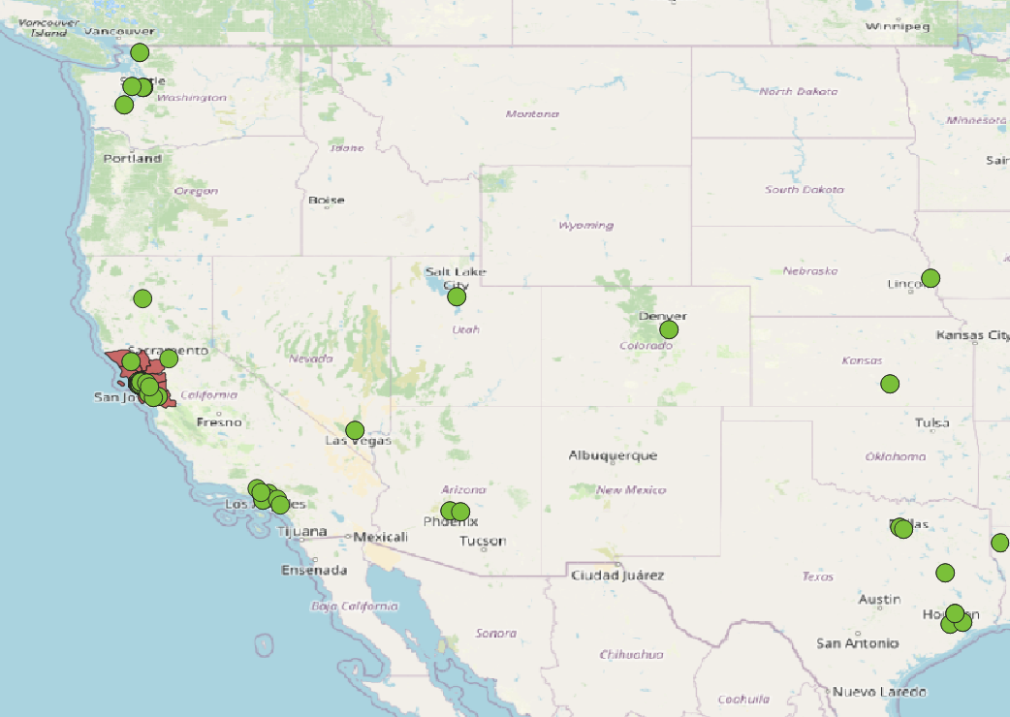
Introduction
Initial analysis
Unstandardized data
Classification
Conclusion
Internship
Suspicious data - coordinates
/ 21

Slide 14
Data Classification
/ 21

Slide 15
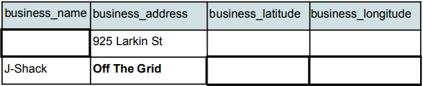
Introduction
Initial analysis
Unstandardized data
Classification
Conclusion
Internship
Filtering criteria
Filtered out duplicate POIs
Inspection attributes and risk not taken into account
Not crucial for task
Inspection scores change over time
Low quality: missing key information
/ 21

Slide 16
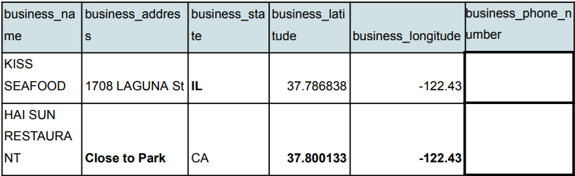
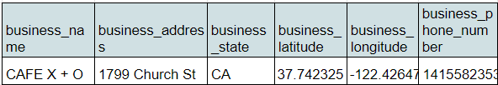
Introduction
Initial analysis
Unstandardized data
Classification
Conclusion
Internship
Filtering criteria
Medium quality: minor issues
Missing/incorrect coordinates
State Illinois
Vague address
Unstandardized zipcode
Missing/unstandardized phone number
High quality: complete data
/ 21

Slide 17
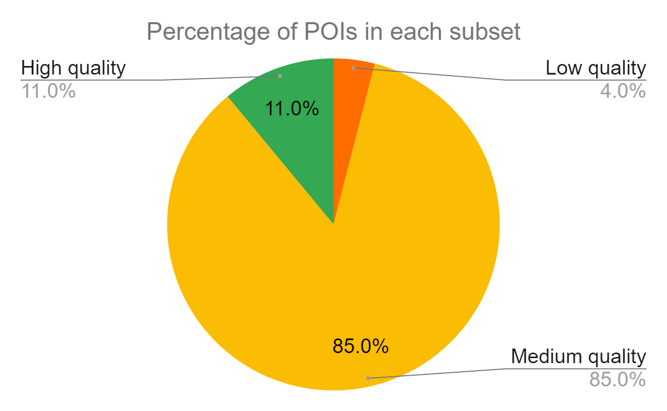
Introduction
Initial analysis
Unstandardized data
Classification
Conclusion
Internship
Classification summary
Low: 230 POIs
Medium: 5,173 POIs
High: 670 POIs
/ 21

Slide 18
Introduction
Initial analysis
Unstandardized data
Classification
Conclusion
Internship
Conclusion
Performed thorough analysis
Small percentage of high quality records
Low quality records not useful
Medium quality records - price negotiation necessary
Possible improvements
/ 21

Slide 19
Introduction
Initial analysis
Unstandardized data
Classification
Conclusion
Internship
Internship tasks 1 & 2
1st month:
Chicago businesses dataset analysis
Python and QGIS
2nd month:
Extended on previous task
Comparison with Google Places API and OpenStreetMap
Python, Rest API and QGIS
/ 21

Slide 20
Introduction
Initial analysis
Unstandardized data
Classification
Conclusion
Internship
Internship task 3
3rd month:
- Analyze roads, railroads and waterbodies in Illinois
- PostgreSQL, PostGIS and QGIS
/ 21

Slide 21
Q&A
/ 21

